Slide 1



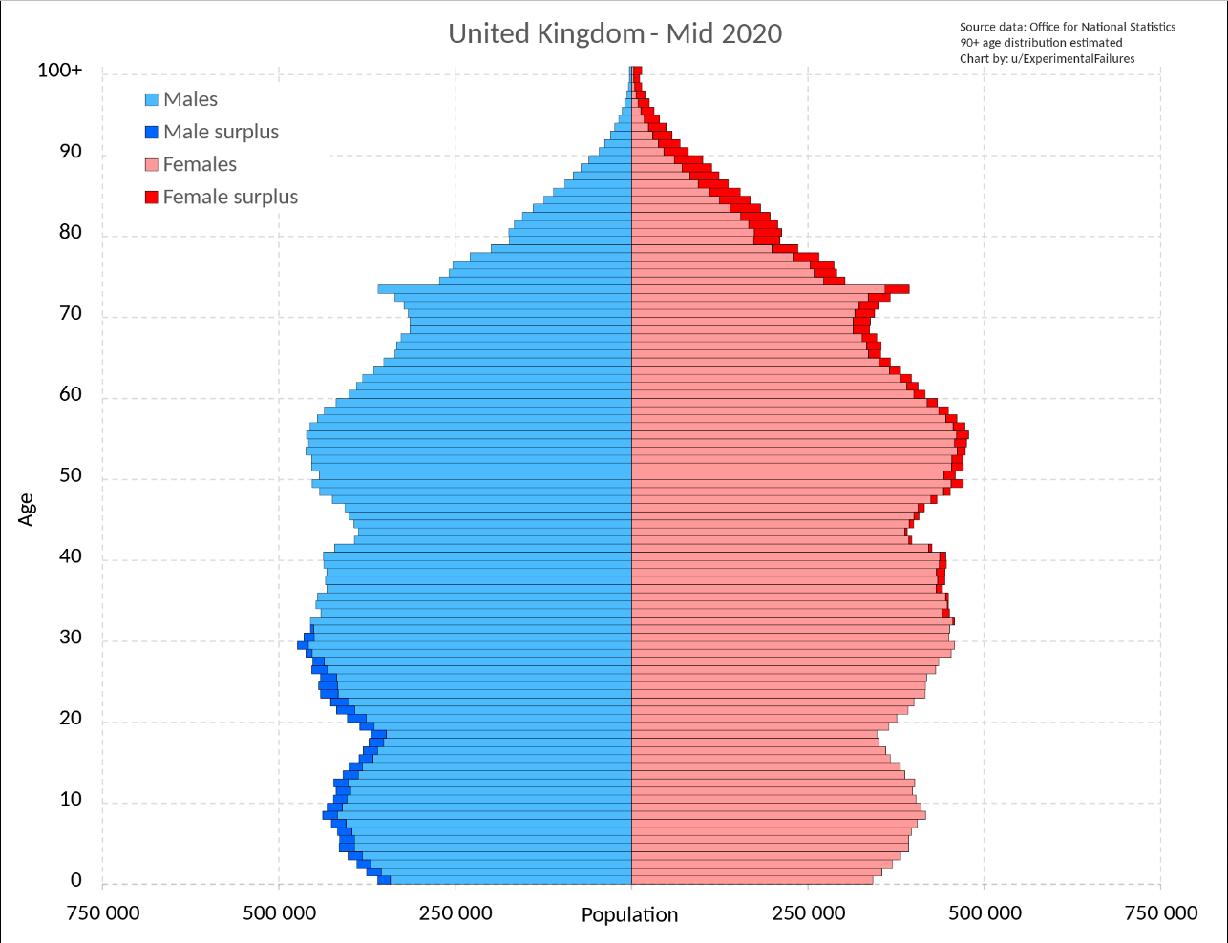



TOTAL
JAMES ATKINSON ENGINEERING DIRECTOR
~ 23 Years (engineering)
Darchem Engineering – 1999 -2007
Primetals – 2007 – Present
Lived & Worked – India, Americas & Europe
10
MAJOR REBUILDS
(Since 2012)
TOTAL
8
METALS INDUSTRY TECHNOLOGY SUPPLIER
~ 7000 Employees (~ 2000 Engineers)
~ Offices in 26 Countries
Design, Supply, Project & Construction Management.
NEW BUILDS
(Since 2000)
~2Te CO₂ /
1Te Liquid Steel.
BF – Responsible
for 75% of CO₂
PRIMETALS UK – Est.1886 (136 yrs) - Davy, Ashmores, Head Wrightson
5 LOCATIONS – Stockton, Sheffield, Scunthorpe, Christchurch, London
~ 300 Employees ( ~ 100 Engineers)
Disciplines –Layout, Pressure Vessel Design, Mechanical , Fluids, Hydraulics, Civil, Structural, Refractory & Projects.
CO₂/GREEN TECHNOLOGY SHIFT
ENGINEERS
TECHNOLOGY
RENEWABLE ENERGY – Generation & Storage
HYDROGEN – Generation, Transport & Industry
ELECTRIFICATION – Transport & Industry
CARBON CAPTURE – Storage & Usage
CO₂ REDUCING EXISTING – Small Gains
SUSTAINABLE MANUFACTURE
ATTRACTING – More Options
RETAINING – Increased mobility, Social Revolution
RETIRING – COVID Demographics
BIM (Building Information Modelling)
3D Printing
3D Scanning & Imaging
Virtual Reality
Digitalisation
BIGGGEST CHANGE IN 70 YRS
DOING MORE WITH LESS
INTEGRATE,DEVELOP & SIMPLIFY

Slide 2



Interest and understanding of basic mechanical & electrical engineering principles.
Hard skills – Read a drawing, understands materials, practical skills.
THE PERFECT CANDIATE
  Enthusiastic, Energetic,
  Quizzical, Problem solver,
  Attention to detail & Organised,
  Robust & Resilient,
  Good Communicator.
Provide basic engineering principles & hard skills (adapted later to industry & technology).
Promote engineering as a career, highlighting roles & show examples of career progression.
Introduction to the opportunities of Green technologies/Industry (NOT the course focus).
Work towards Multi-disciplined & Flexible candidates.
Soft Skill training - Communication with Global partners, Customers and Supply chains (the Norm).
Primetals Historically 50/50 split of Apprenticeships & Graduates. +80% of Senior Roles are from Technical background.
Industry to engage earlier with education providers & explain career opportunities. We need a wider pool of candidates.
To attract and Retain industry needs to recognise that there is a Social Revolution. We need to provide environment, team, role, opportunities, learning (Training) & rewards and accept a turnover of staff.

